Slide 1
Robust Learning with Missing Data
robust Bayesian estimator

Slide 2
Introduction
The Bayesian estimation
classification and clustering
Unfortunately, when the database is incomplete, i.e., some entries are reported as unknown, the simplicity and efficiency of this analysis are lost.

Slide 3
Exact Bayesian analysis
replacing the missing entries with some value and then computes their average estimate
the number of the completed databases increases exponentially with the number of missing entries

Slide 4
If data are missing at random
expectation maximization algorithm
Gibbs sampling
the missing values can be inferred from the available data

Slide 5
robust Bayesian estimator (RBE)
no assumption about the missing data mechanism

Slide 6
Learning conditional probabilities
X = {X1, . . . , Xv}------a set of variables
S------a graph of conditional dependencies among the variables in X
A conditional dependency links a child variable Xi to a set of parent variables ∏_{i}

Slide 7
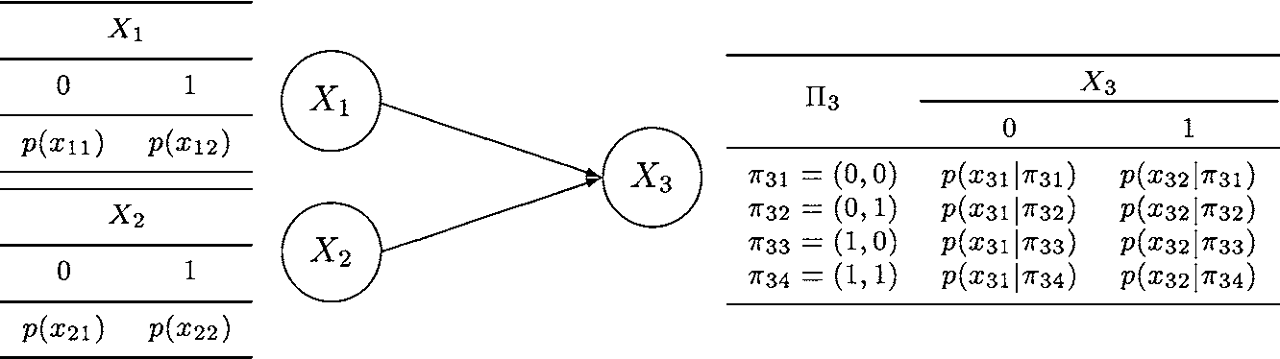

Slide 8
When the database is complete
n(x_{ik} |π_{ij})------the frequency of cases in which the variable X_{i} appears in its state x_{ik} together with the combination π_{ij} of its parents ∏_{i}
n(π_{ij} ) = ∑_{k} n(x_{ik}|π_{ij} )

Slide 9



Slide 10
Rubin (1976) classifies missing data mechanisms into three categories
missing completely at random (MCAR): the probability that an entry will be missing is independent of both observed and unobserved values in the data set;
missing at random (MAR): the probability that an entry will be missing is a function of the observed values in the data set;
informatively missing (IM): the probability that an entry will be missing depends on both observed and unobserved values in the data set.

Slide 11


Virtual frequencies

Slide 12
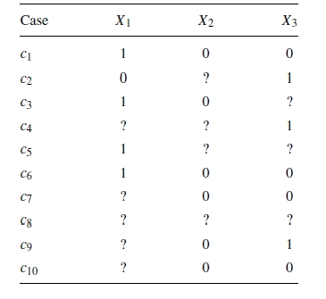
Virtual frequencies

Slide 13
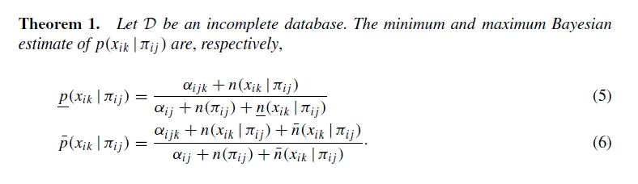
The robust Bayesian estimator

Slide 14
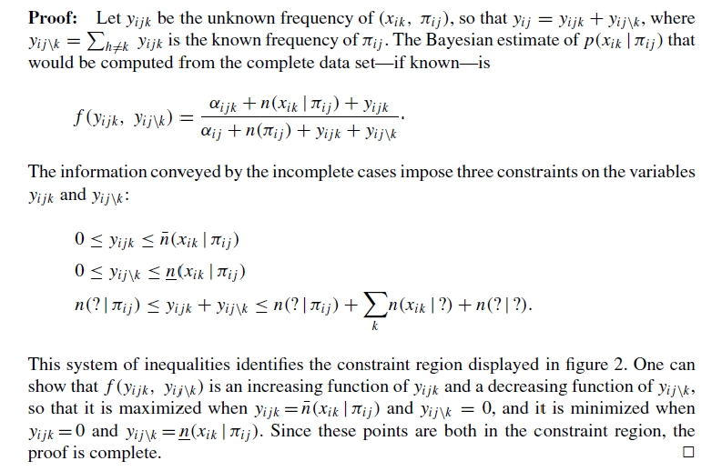

Slide 15


Slide 16
Interval-based inference
the width w
1 − w
small values denoting lack of reliability and values near 1 denoting high reliability

Slide 17
The stochastic dominance criterion
selects the value x_{ik} of X_{i} if the minimum probability is larger than the maximum probability , for any h != k.
Stochastic dominance is the safest and most conservative criterion since the prediction is independent of the distribution of missing data.

Slide 18
When the probability intervals are overlapping
Let q(x_{ik}) be the probability that an unknown value of X_{i} must be completed as x_{ik}

Slide 19
MAR or MCAR
Stochastic dominance
Let q(x_{ik}) = 0

Slide 20
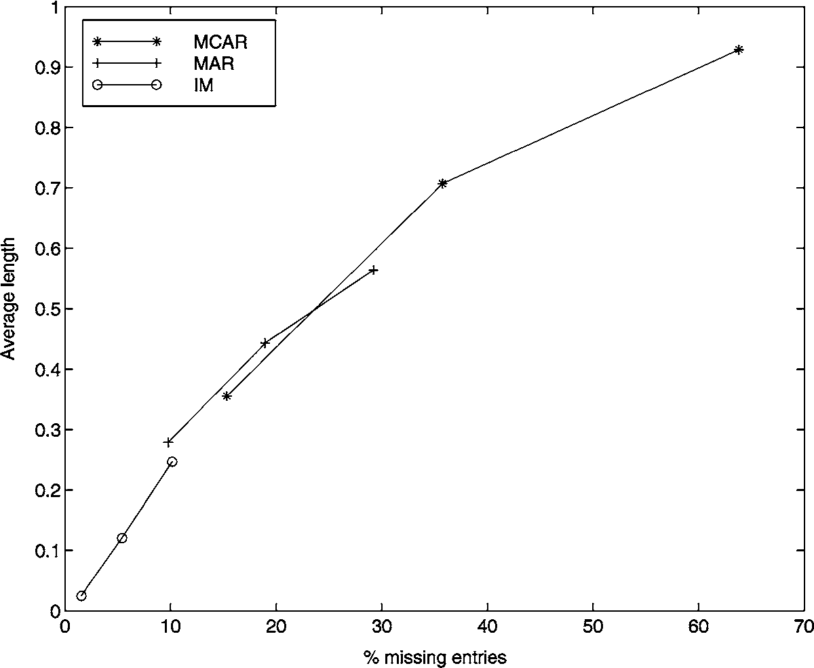
evaluate the reliability

Slide 21
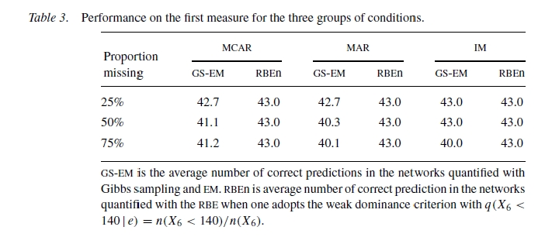

Slide 22
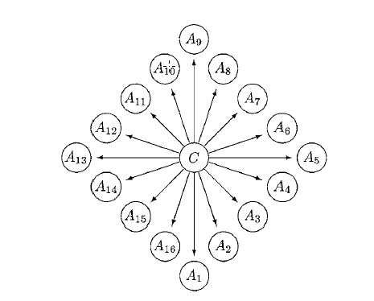
An application to a classification task

Slide 23

calculate the posterior probability of the C = c _{j} given the set of attribute values e_{k}

Slide 24

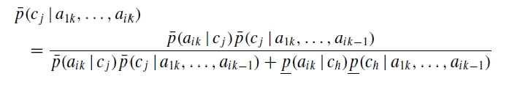

Slide 25
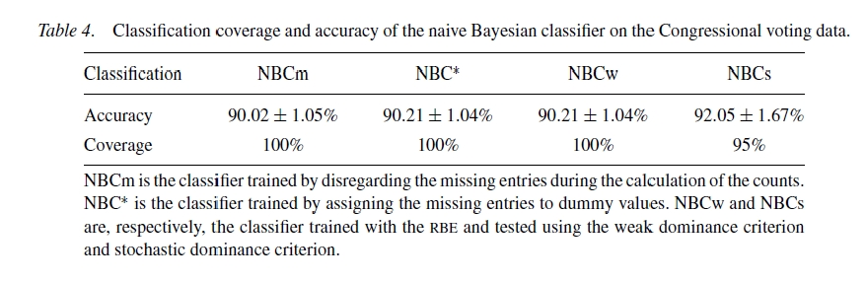

Slide 26
Conclusions

